Slide 1
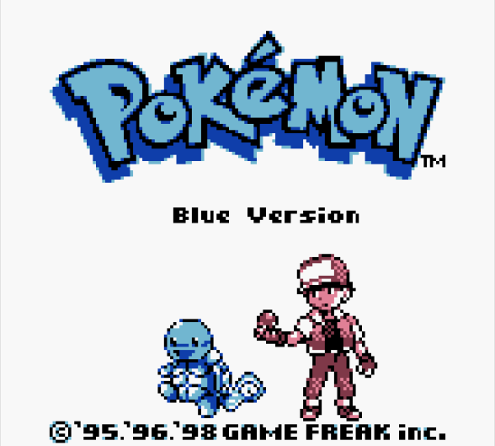
Progress Report 2
Edesia: System/Algorithm Design and Analysis
Team Blue
Adam Bowers | Daniel Wingo | Stephen Bennett | Jonathan Holley
Github: aLotofAdam | 81wingo | stephenbennett2 | mccauley747
UNCG: ajbower3 | dtwingo | scbenne3 | jbholley

Slide 2
Detailed Design and Controls

Slide 3
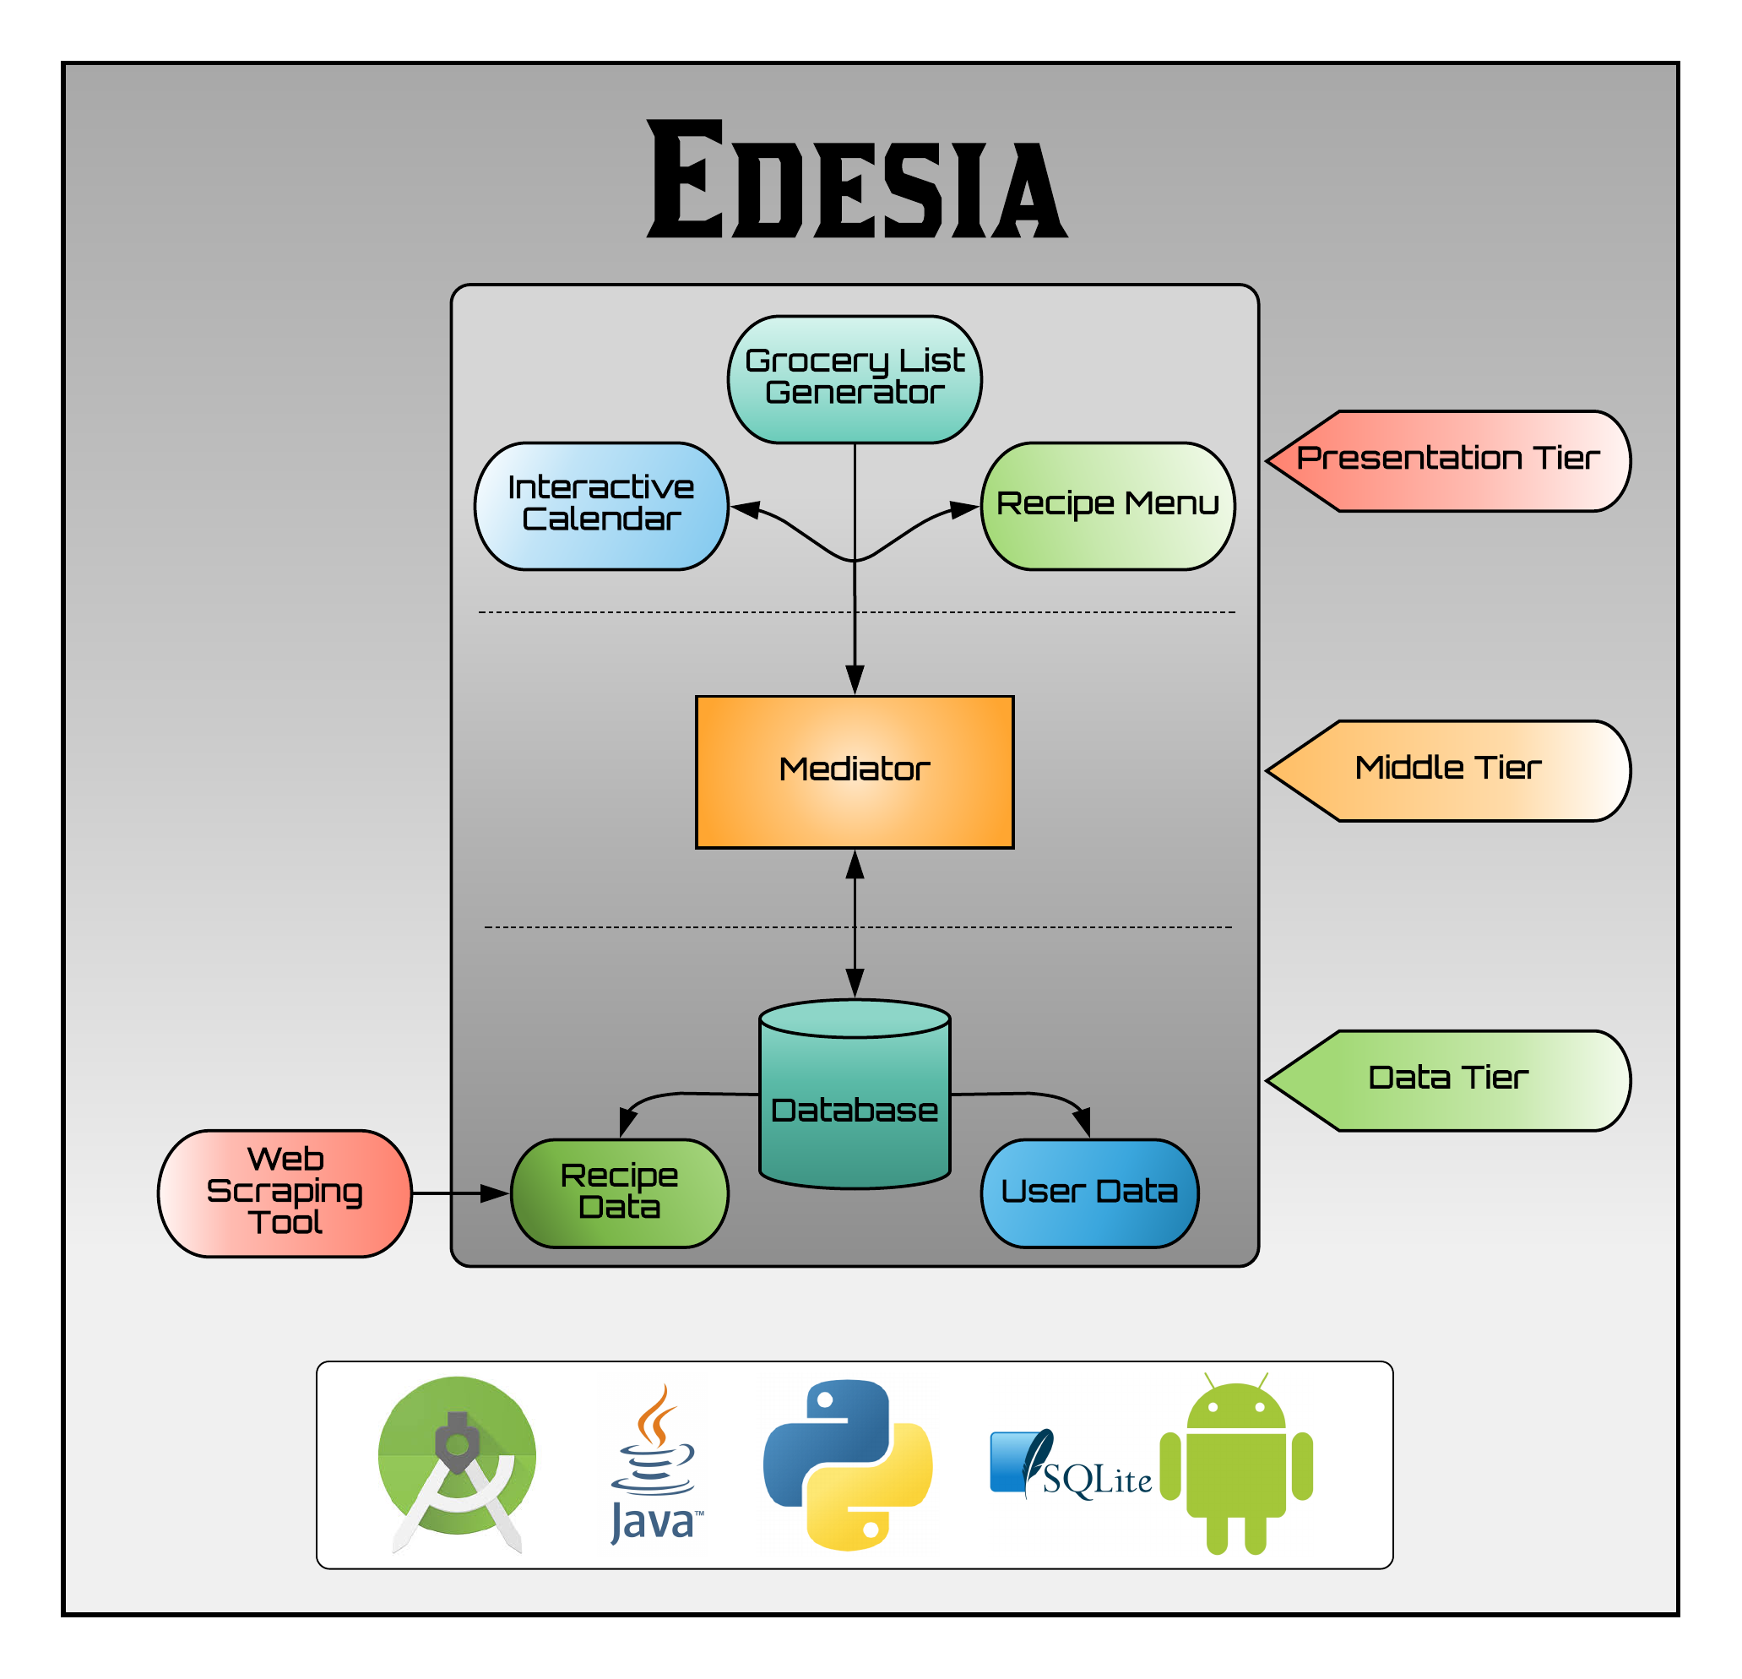
System Model:
3-Tier Architecture
Presentation Tier:
User interfaces
Middle Tier:
Process commands
Moves data between layers
Coordinates application
Data Tier:
Stores data

Slide 4
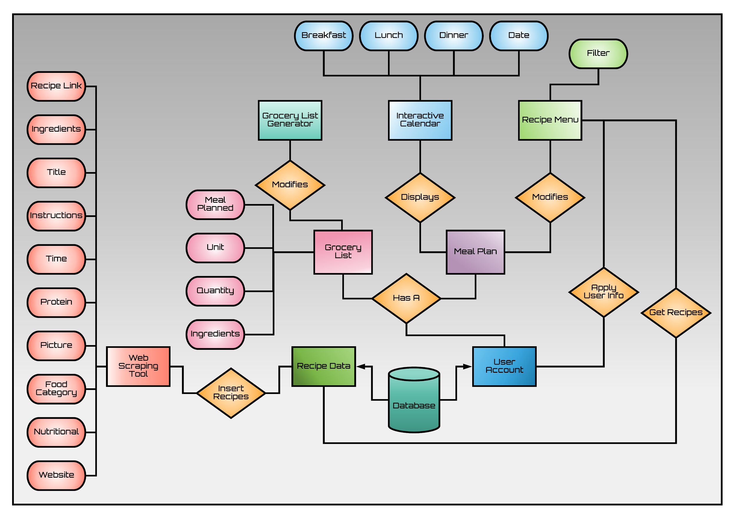
System ER Diagram

Slide 5
Amended Models

Slide 6
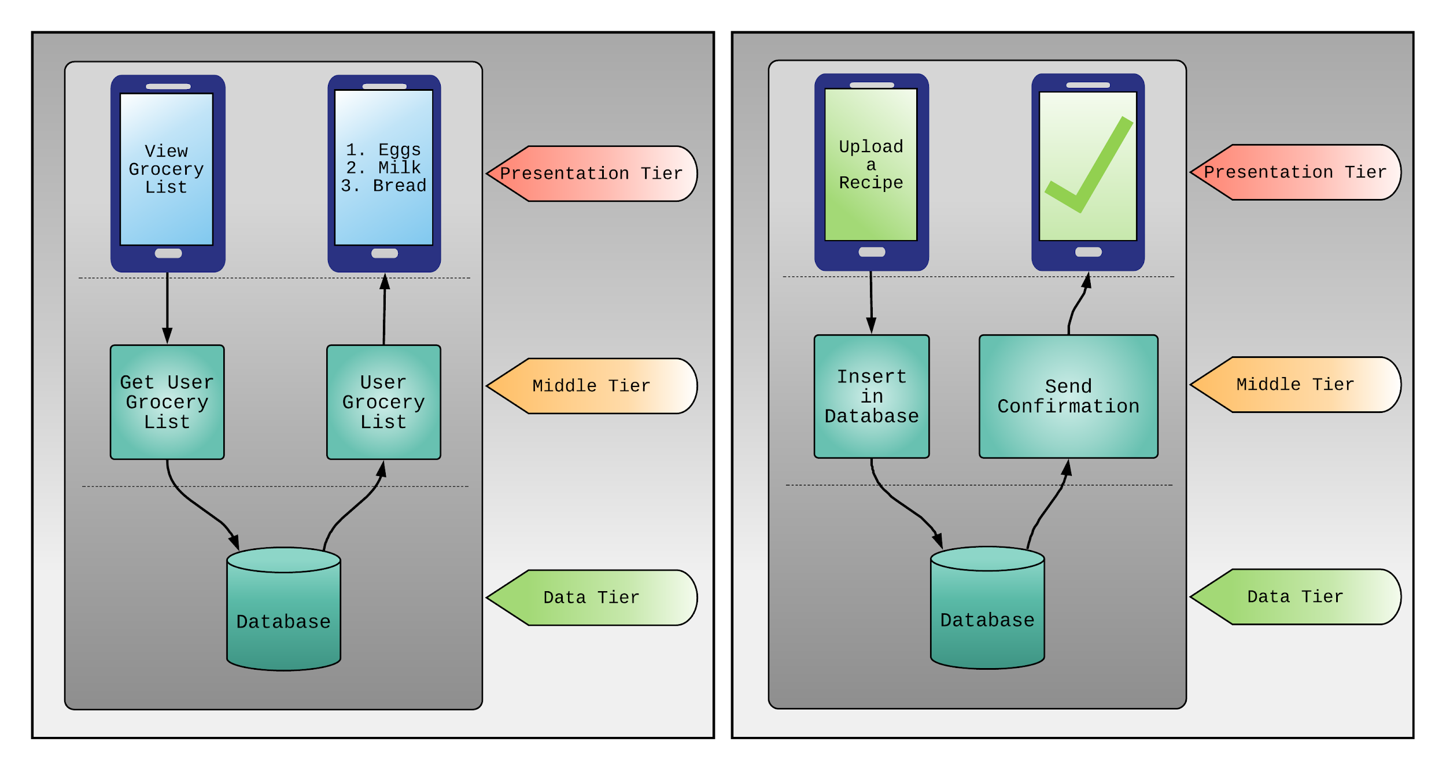
Process Models

Slide 7
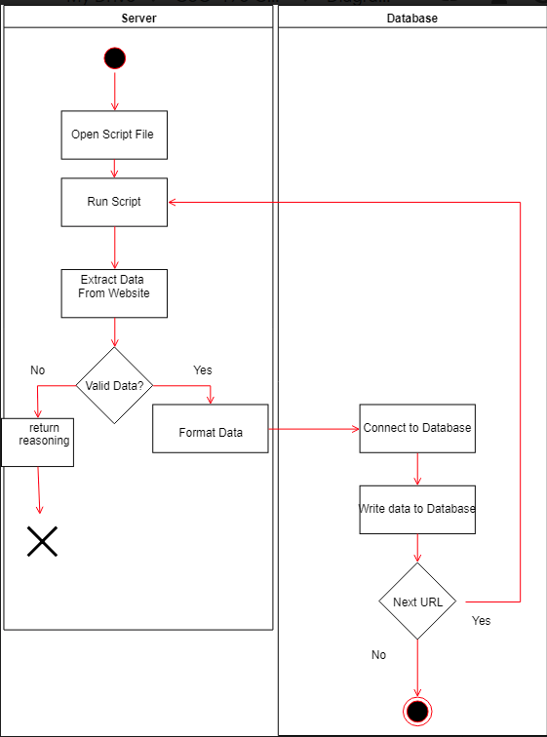
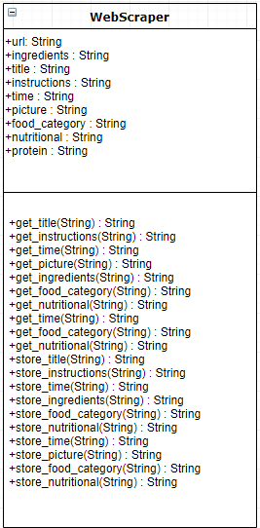
Class Diagram Activity Diagram
Web Scraper

Slide 8
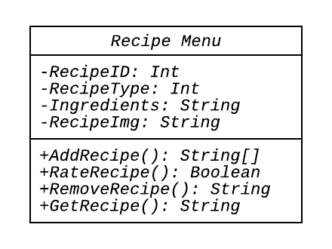
Recipe Menu
Class Diagram

Slide 9
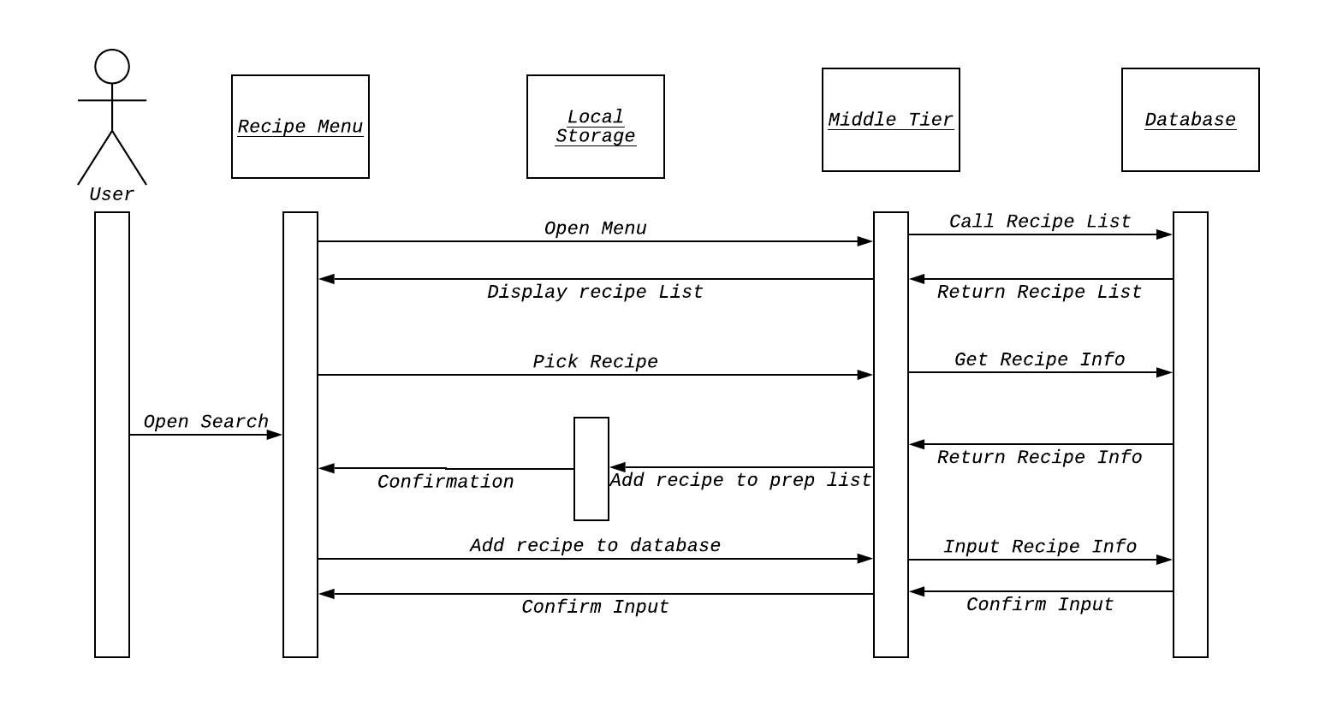
Sequence Diagram

Slide 10
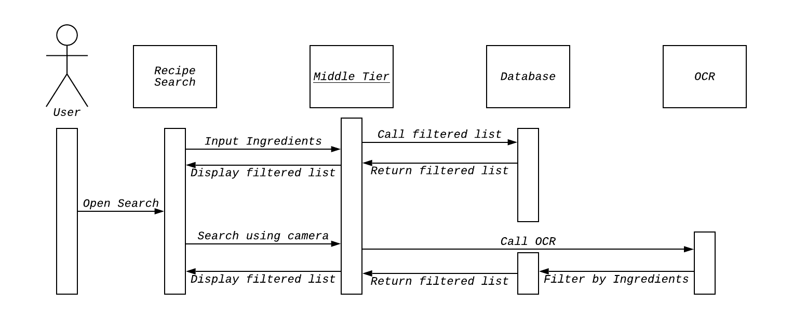
Recipe Based on Ingredients available

Slide 11
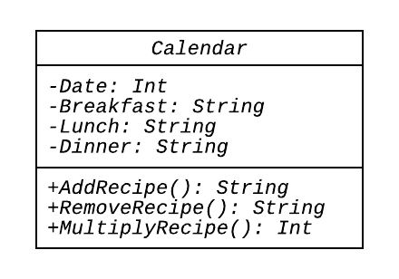
Calendar
Class Diagram

Slide 12
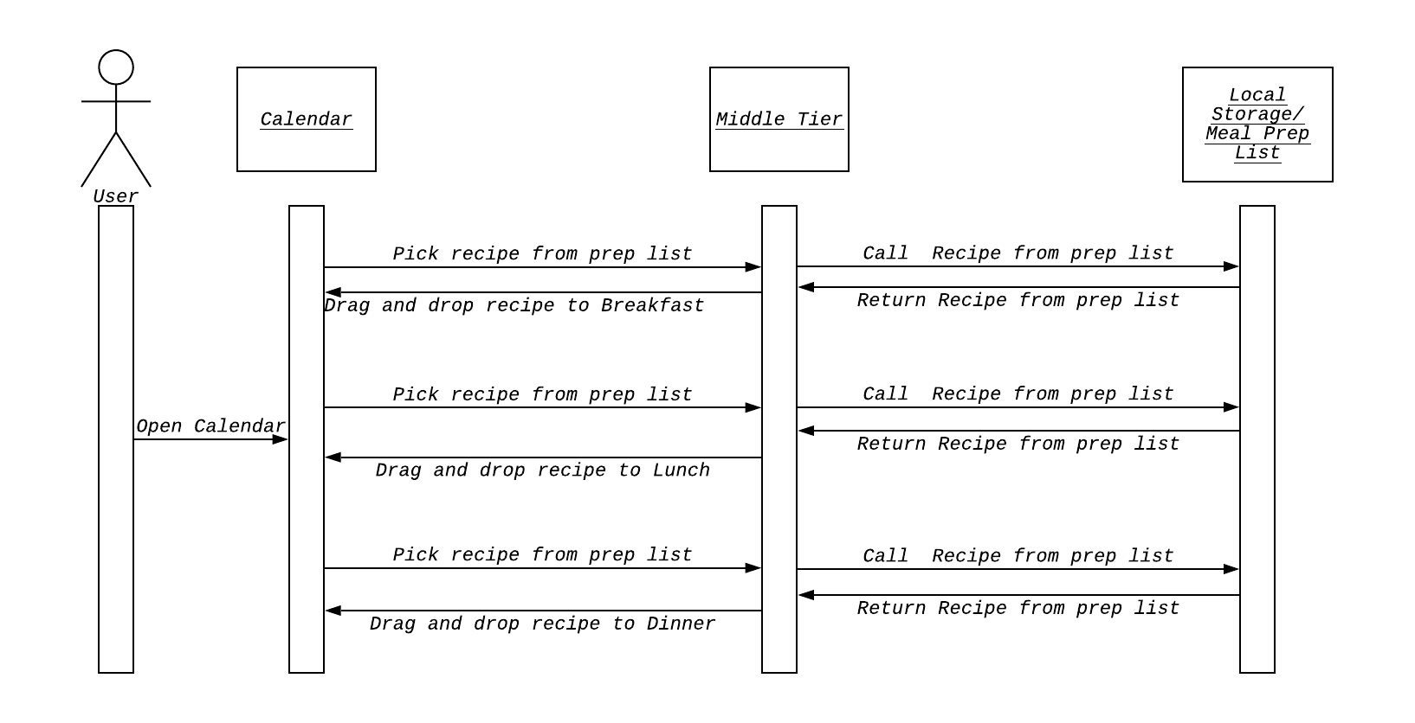
Sequence Diagram

Slide 13
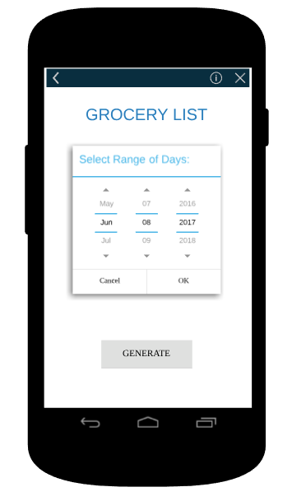
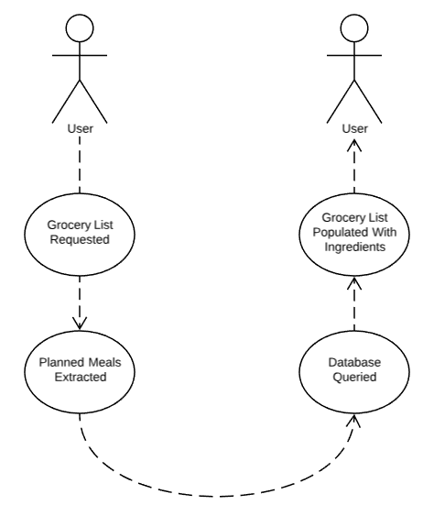
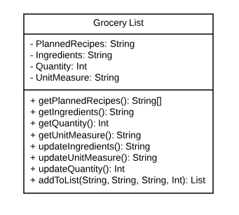
Grocery List Generator
Mockup Flow Diagram Class Diagram

Slide 14
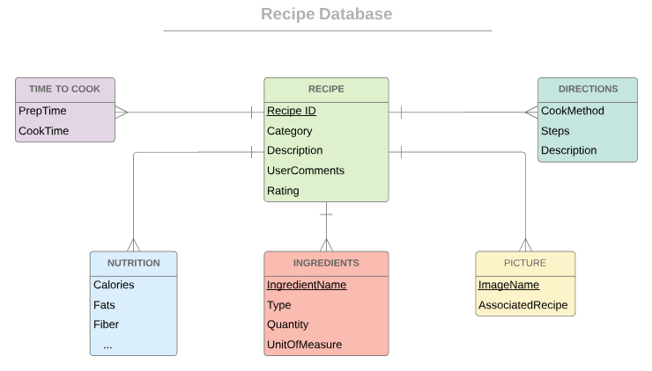
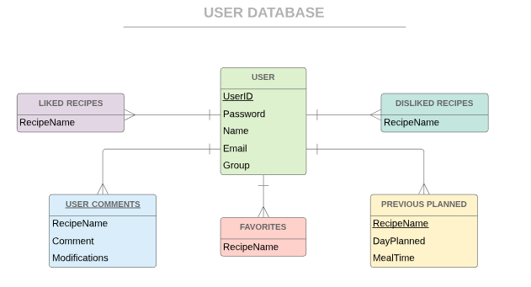
Database ER

Slide 15
Systems/Algorithm Analysis

Slide 16
Algorithm Analysis
The web scraper we are more worried about accuracy versus speed. But to insert the data it will be O(1).
SQLite Database uses a B-Tree so the time complexity is O(log n) for insert, delete and search of database(s).
The Recipe Search will be limited by the database so it should also have a time complexity of O(log n).

Slide 17
Data Dictionary

Slide 18
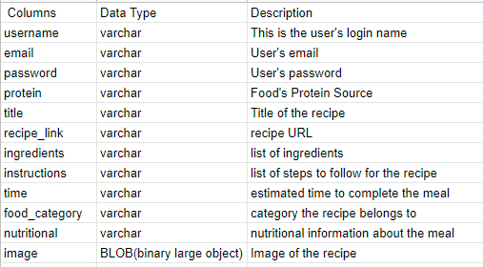
Data Dictionary Format

